Slide 1
Capstone Project – Car Accident Severity: Seattle
NC

Slide 2
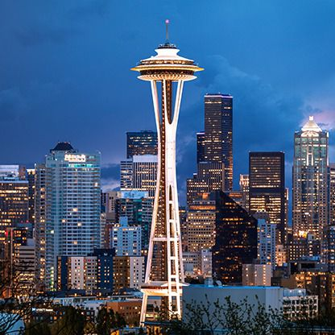
Introduction
Background
Road traffic injuries cause considerable economic
Road traffic accident caused most countries 3% of their GDP
Hence it is important to analyse the severity of accidents and their causes

Slide 3
Introduction
Business Problem
To predict the severity of accidents happening on the roads of Seattle based on multiple attributes
Target Audience
State Departments
Drivers
Logistic Companies
Cab Companies etc.

Slide 4
Data Acquisition and Cleaning
Data Source
Data is from Seattle Department of Transportation in CSV format
The dataset is around 200,000 events
Data Cleaning & Feature Selection
Total 37 attributes
4 attributes were chosen based on negative correlation with the severity – WEATHER, ROADCOND, LIGHTCOND, VEHCOUNT

Slide 5
Methodology
Data Analysis
& Preparation and Normalization
Data Balancing
Check & change the dtype
Normalize the dataset
Train Test Spilt
Modelling/ Classification Source
K-Nearest Neighbours (KNN)
Decision Tree (DT)
Logistic Regression (LR)

Slide 6
Result and Discussion
The best model: combination of high F1-score, high jaccard similarity score and the smallest log loss
The best performance is observed in Decision Tree model
 | KNN | DT | LR
Accuracy | 0.5999 | 0.6075 | 0.5233
F1-Score | 0.5953 | 0.5828 | 0.5139
Jaccard similarity score | 0.4684 | 0.5200 | 0.2869
Log Loss | - | - | 0.6811

Slide 7
Conclusion
To predict the severity of the car accidents that will happen in Seattle based on the known conditions like weather, lighting conditions, road condition and vehicle count
Model can be used by individuals and many sectors
Prepare them to handle the situation more effectively

Slide 8
Thank you

